Slide 1
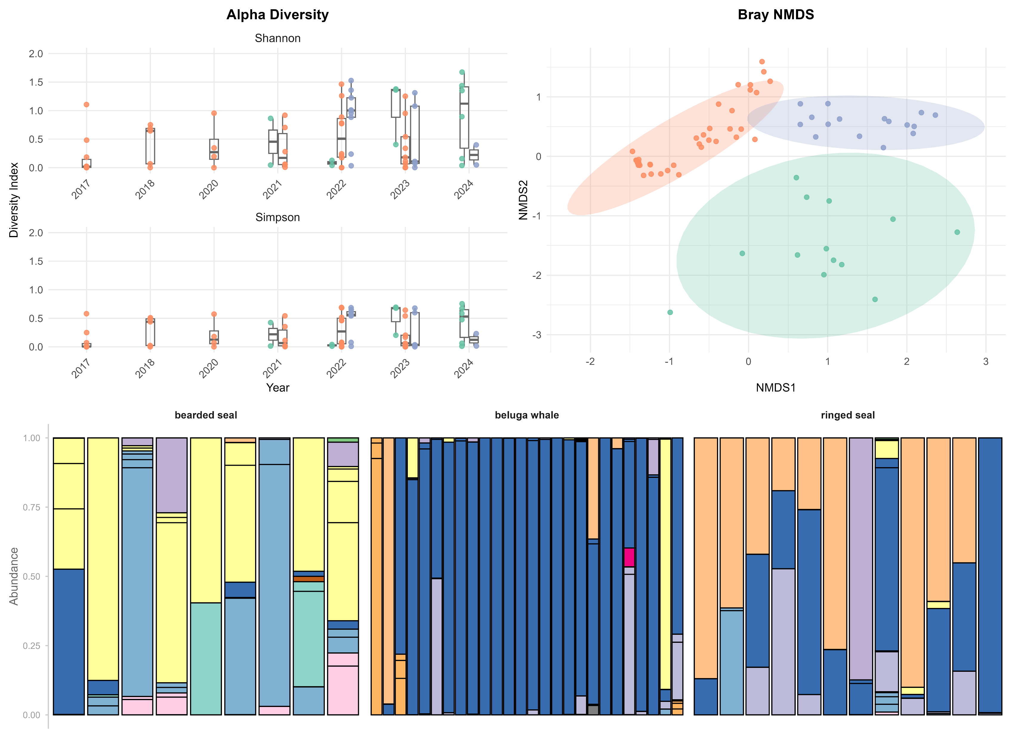
A
B
C
Figure 1: Alpha diversity and community composition of fish prey detected by 12S metabarcoding in three Arctic marine predators. (A) Alpha diversity (Shannon and Simpson indices) of gut contents is shown by year for bearded seals, beluga whales, and ringed seals; points represent individual samples and boxplots summarize predator–year distributions. (B) Non-metric multidimensional scaling (NMDS) ordination based on Bray–Curtis dissimilarities of relative read abundance illustrates differences in overall prey community composition among predators; points are individual samples, colored by predator, and shaded ellipses represent 95% confidence regions. (C) Stacked bar plots of relative read abundance at the family level display prey taxonomic composition of individual samples, faceted by predator; bars are samples and colors denote fish families. Together, panels indicate that predators differ in both prey diversity and taxonomic composition, with partially overlapping but distinct multivariate prey assemblages.

Slide 2
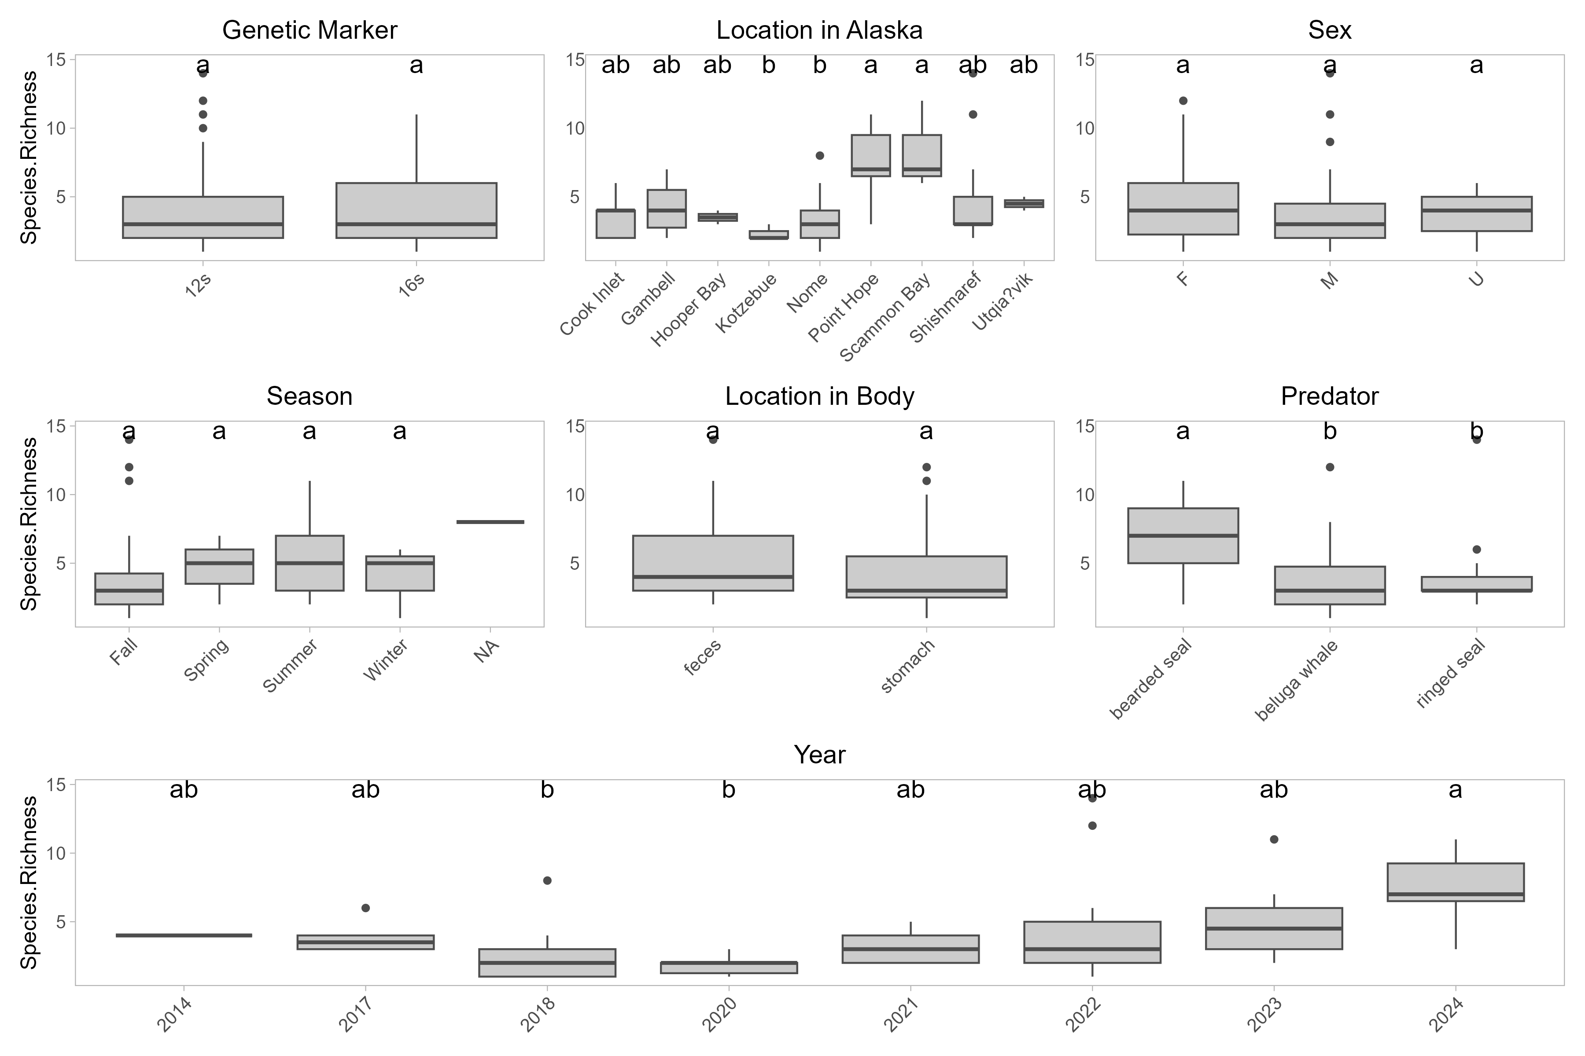
Figure 2: Effects of sampling and biological factors on fish prey species richness in Arctic marine predators. Boxplots show variation in metabarcoding-derived species richness across genetic markers, collection locations in Alaska, sex, season, body compartment (stomach vs. feces), predator species, and year of collection. Letters above boxes indicate Tukey HSD groupings from one-way ANOVAs within each panel, with shared letters denoting non-significant differences. Together, panels highlight which ecological and sampling variables are most strongly associated with variation in detected fish prey richness.

